Slide 1
Cluster Expansion for Pd dynamics

Slide 2
Steps
1. Try 2D layer first
7 clusters
Less than 20 configurations (some of them are not 2D)

Slide 3
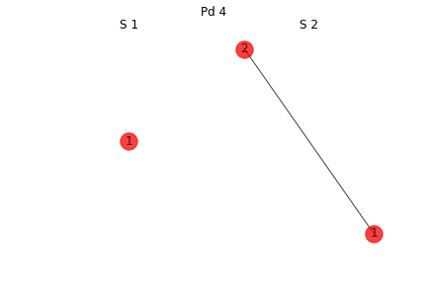
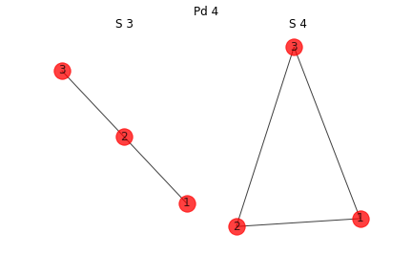
Clusters 1

Slide 4
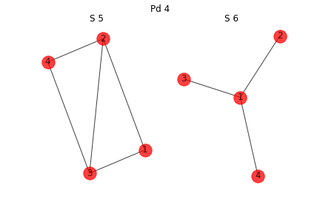
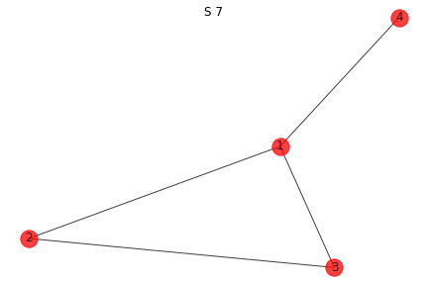
Clusters 2

Slide 5
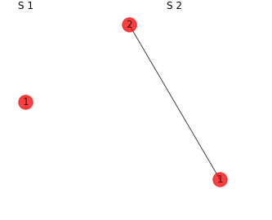
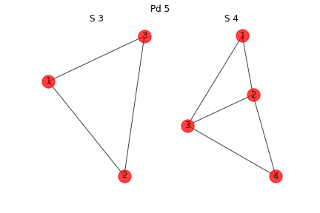
Configurations 1

Slide 6
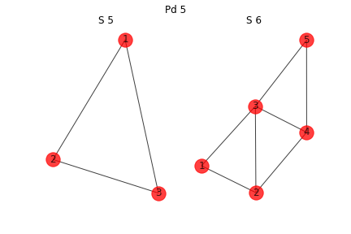
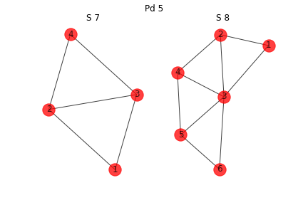
Configurations 2
This is a 3D cluster
This is a 3D cluster

Slide 7
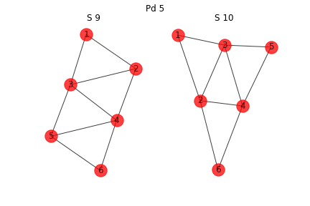
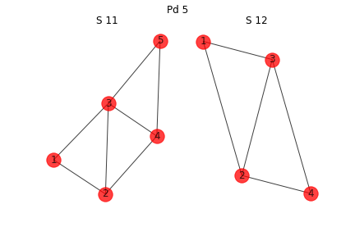
Configurations 3
This is a 3D cluster
This is a 3D cluster

Slide 8
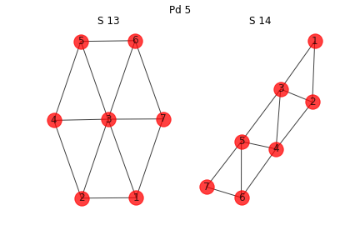
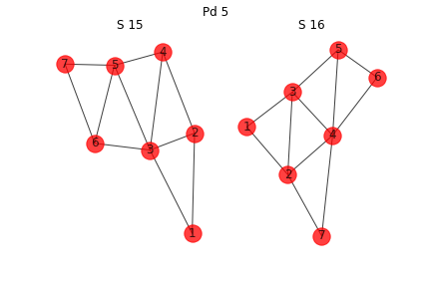
Configuration 4

Slide 9
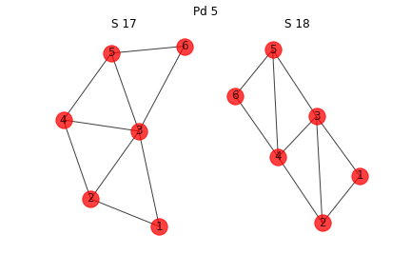
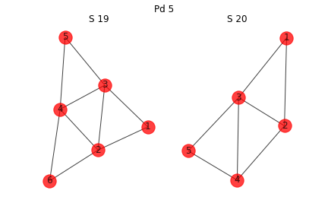
Configuration 5
This is a 3D cluster
This is a 3D cluster
This is a 3D cluster
This is a 3D cluster

Slide 10
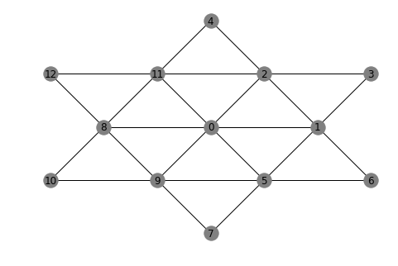
Lattice

Slide 11
Model 2D configuration first
12 of them

